Slide 1
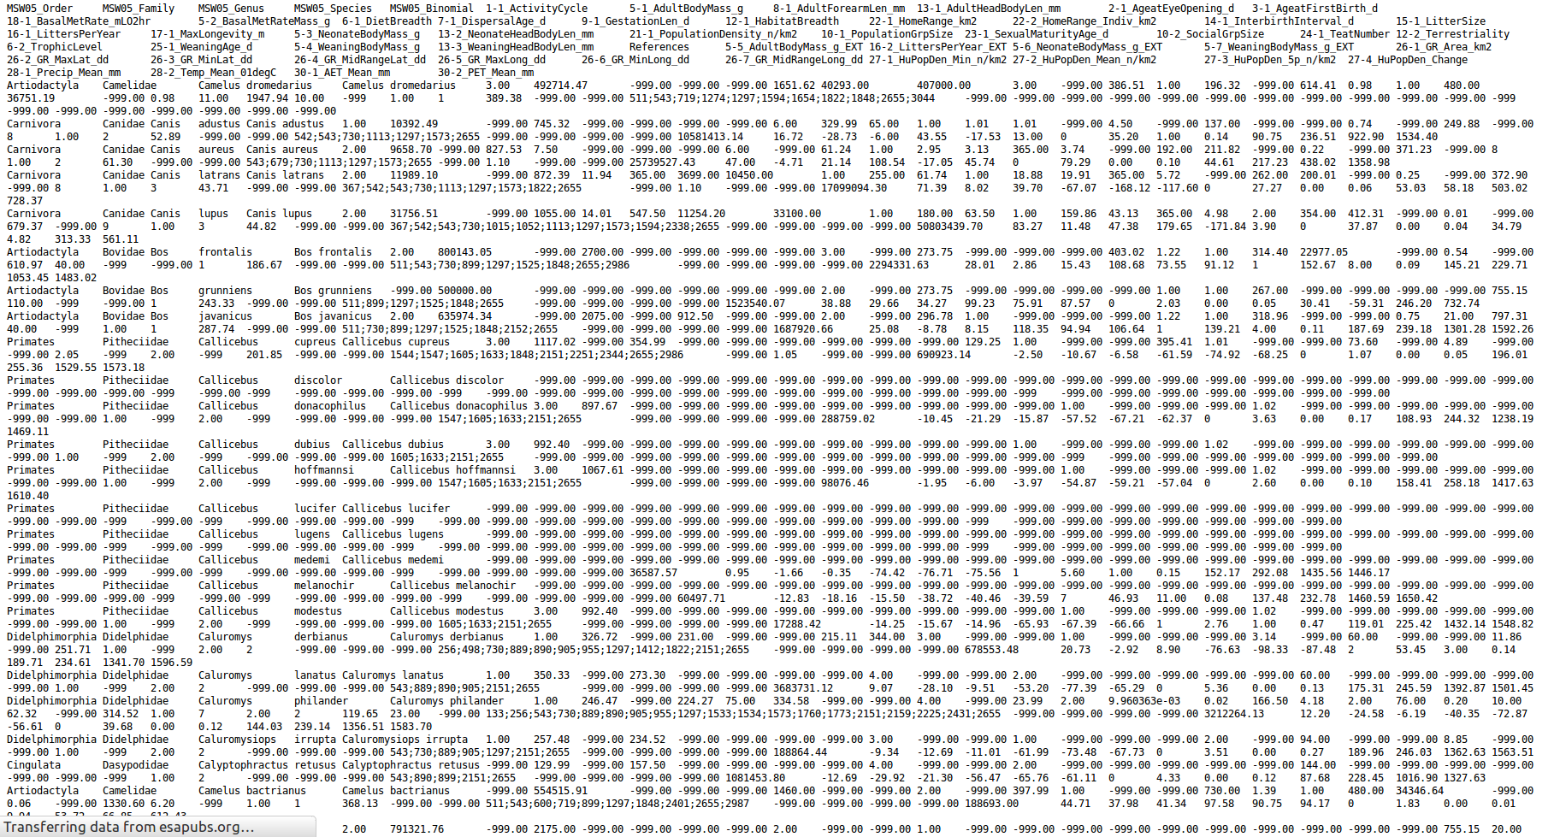
Missing data
Moreno Di Marco
m.dimarco@uq.edu.au

Slide 2
Missing data resources
P. E. McKnight, K. M. McKnight, S. Sidani, A. J. Figueredo, Missing Data: A Gentle Introduction (Methodology In The Social Sciences) (The Guilford Press, 2007).
S. Nakagawa, R. P. Freckleton, Missing inaction: the dangers of ignoring missing data. Trends Ecol. Evol. 23, 592–6 (2008).
C. Penone et al., Imputation of missing data in life-history traits datasets: which approach performs the best? Methods Ecol. Evol. 5, 961–970 (2014).

Slide 3
What are missing data and why they are missing
The best solution to handle missing data is to have none.
R.A. Fisher
Missing data occur when one or more information are missing from a dataset.
Incomplete information, i.e. missing data, is a common situation in most conservation-relevant datasets. Data missingness can be associated to unequal sampling effort (e.g. charismatic vs non-vharismatic species), or issue with data collection in particular situations (e.g. remote areas).
Examples of missing data include:
- Missing data for one or more life-history traits for one or more species (e.g. unknown weaning age of rodents)
- Missing population data for data deficient species in the IUCN Red List
- Missing Human Population density for small islands
- Missing boundary information for protected areas in the WDPA

Slide 4
Handling missing data: data deletion
Should I just omit non-complete cases from my analysis?
e.g. remove species missing one or more life-history traits
You can do it, but in doing so you are:
Throwing away a large part of the dataset
Reducing the power of your analysis
Assuming that the data you are missing are “missing completely at random” (MCAR), and if this is not the case
Probably introducing a bias in your analysis

Slide 5
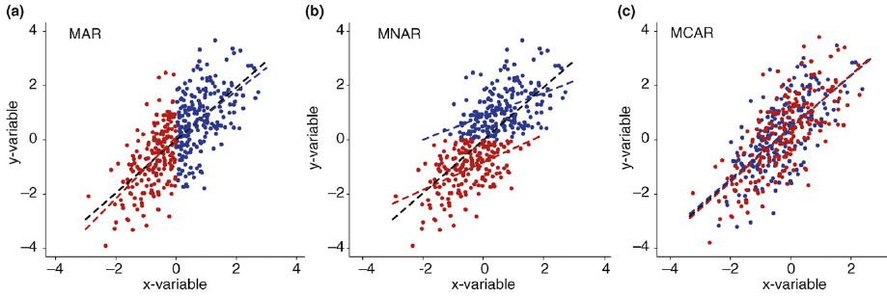
Are my data missing completely at random?
● Missing data for the y-variable
Missing At Random
Data missingness depend on the values of the x-variable, but not on the values of the y-variable
Missing Non At Random
Data missingness depend on the values of the y-variable itself
Missing Completely At Random
Data missingness does not depend on the values of the x- or y-variables

Slide 6
What happen if omitting non-complete cases?
● Missing data for the y-variable
Missing At Random
Reduced explanatory power
Data Imputation techniques generally assume MAR.
Missing Non At Random
Reduced explanatory power + bias in parameter estimation
Missing Completely At Random
No significant bias in results

Slide 7
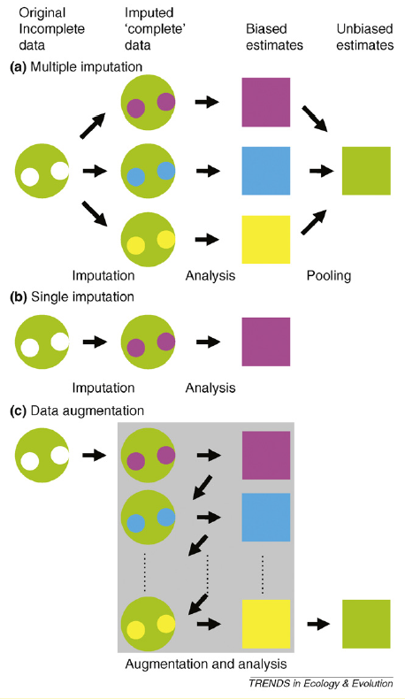
Handling missing data: single imputation techniques
Missing values are assigned a single values, based on a given function of other observations .
A typical example of single imputation is the “mean substitution”, in which missing life-history traits are filled using the mean trait values of phylogenetically related species.
Single imputation, and especially mean substitution, can lead to large underestimation of uncertainty in parameters (e.g. standard error).

Slide 8
Handling missing data: multiple imputation techniques
Multiple imputation is done in three steps:
Perform m independent single imputations, and generate m complete datasets
Analyse each m dataset independently, estimate m parameters
Pool together the m parameters to estimate the mean parameter value and its uncertainty
Multiple Imputation can provide information regarding the impact of missing data on parameter estimation (“Rate of Missing Information”)

Slide 9
Handling missing data: data augmentation
Data augmentation is different from multiple imputation as it does not explicitly replace missing values with values which we can actually see.
E.g. A maximum likelihood data augmentation procedure choose estimates with values that maximize the probability of obtaining the observed data. This is accomplished by the use of a formula (the likelihood function) that estimates the likelihood of the data as a function of both the data and the unknown parameters. When data are missing, the likelihood can be obtained by estimating probabilities over all possible values of the missing data and summing them.

Slide 10
Imputation of data, which method performs the best?
Penone et al. (2014) Meth Ecol Evol
From a complete dataset, remove some of the data
Use different imputation techniques to fill the missing data
Compare the outcomes of these techniques in terms of: - similarity between removed data and imputed data - similarity between the actual (complete data) and approximated (incomplete data) parameters of an allometric relationship
Estimating an allometric relationship, in mammalian carnivores
longevity ~ body mass
what is the effect of missing data?

Slide 11
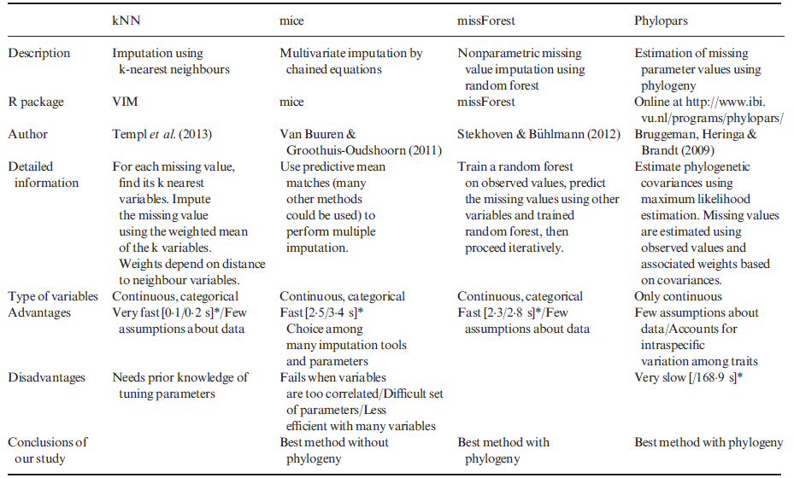
Methods for imputation of missing data

Slide 12
Imputation of data, which method performs the best?

Slide 13

Hey don’t trow away your missing data cases, impute them!
Arthur H. Fonzarelli "Fonzie" (2016) Pers. Comm.

